Slide 1
UNIT –II
Inheritance, Packages and Interfaces
Inheritance in Java is a mechanism in which one object acquires all the properties and behaviors of a parent object. It is an important part of OOPs (Object Oriented programming system).
The idea behind inheritance in Java is that you can create new classes that are built upon existing classes. When you inherit from an existing class, you can reuse methods and fields of the parent class. Moreover, you can add new methods and fields in your current class also.
In Java, it is possible to inherit attributes and methods from one class to another. We group the "inheritance concept" into two categories:
subclass (child) - the class that inherits from another class
superclass (parent) - the class being inherited from
To inherit from a class, use the extends keyword.
Inheritance represents the IS-A relationship which is also known as a parent-child relationship.
Why use inheritance in java
For Method Overriding (so runtime polymorphism can be achieved).
For Code Reusability.

Slide 2
Important Terminologies Used in Java Inheritance
Class: A class is a group of objects which have common properties. It is a template or blueprint from which objects are created.
Sub Class/Child Class: Subclass is a class which inherits the other class. It is also called a derived class, extended class, or child class.
Super Class/Parent Class: Superclass is the class from where a subclass inherits the features. It is also called a base class or a parent class.
Reusability: As the name specifies, reusability is a mechanism which facilitates you to reuse the fields and methods of the existing class when you create a new class. You can use the same fields and methods already defined in the previous class.
The syntax of Java Inheritance
class Subclass-name extends Superclass-name
{
//methods and fields
}

Slide 3
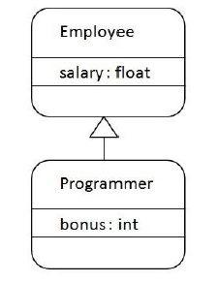
The extends keyword indicates that you are making a new class that derives from an existing class. The meaning of "extends" is to increase the functionality.
class Employee{
float salary=40000;
}
class Programmer extends Employee
{
int bonus=10000;
public static void main(String args[])
{
Programmer p=new Programmer();
System.out.println("Programmer salary is:"+p.salary);
System.out.println("Bonus of Programmer is:"+p.bonus);
} }
Programmer is the subclass and Employee is the superclass. The relationship between the two classes is Programmer IS-A Employee. It means that Programmer is a type of Employee.

Slide 4
Types of inheritance in java
On the basis of class, there can be three types of inheritance in java: single, multilevel and hierarchical.
In java programming, multiple and hybrid inheritance is supported through interface only.
Single inheritance
Multilevel inheritance
Hierarchical inheritance
Multiple inheritance
Hybrid inheritance

Slide 5
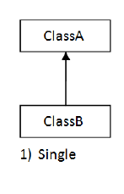
1. Single inheritance
When a class inherits another class, it is known as a single inheritance
In single inheritance there exists single base class and single derived class.
package inheritance;
class Animal{
void eat() {
System.out.println("eating...");} }
class Dog extends Animal {
void bark() {
System.out.println("barking...");} }
class TestInheritance{
public static void main(String args[]){
Dog d=new Dog();
d.bark();
d.eat();
}}
Dog class inherits the Animal class,
so there is the single inheritance.

Slide 6
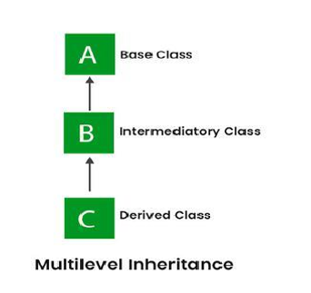
2. Multilevel inheritances in Java
  When there is a chain of inheritance, it is known as multilevel inheritance.
  In Multilevel inheritances there exists single base class, single derived class and multiple intermediate base classes.

Slide 7
package inheritance;
class Animal2
{
String name;
void show()
{
System.out.println("Animal Name is: "+name);
}
}
class Dog2 extends Animal2
{
void bark()
{
System.out.println("Mother Dog Barking...");
}
}
class BabyDog extends Dog2
{
void weep()
{
System.out.println("Baby Dog weeping");
}
}
class TestInheritance2
{
public static void main(String args[])
{
BabyDog d=new BabyDog(); d.name="MotherDog"; d.show();
d.bark();
d.weep();
}
}
BabyDog class inherits the Dog class which again inherits the Animal class, so there is a multilevel inheritance.

Slide 8
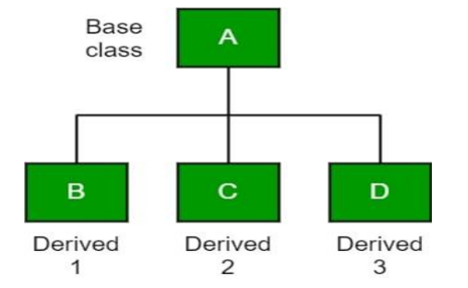
3. Hierarchical Inheritance
When two or more classes inherits a single class, it is known as hierarchical inheritance.
In Hierarchical Inheritance, one class serves as a superclass (base class) for more than one subclass. In the below image, class A serves as a base class for the derived class B, C and D.

Slide 9
class Cat extends Animal3
{
void meow()
{
System.out.println("meowing...");
}
}
class TestInheritance3
{
public static void main(String args[])
{
Cat c=new Cat();
c.meow();
c.eat();
//c.bark();//C.T.Error
}
}
package inheritance;
class Animal3
{
void eat()
{
System.out.println("eating...");
}
}
class Dog3 extends Animal3
{
void bark()
{
System.out.println("barking...");
}
}
Dog and Cat classes inherits the Animal class, so there is hierarchical inheritance.

Slide 10
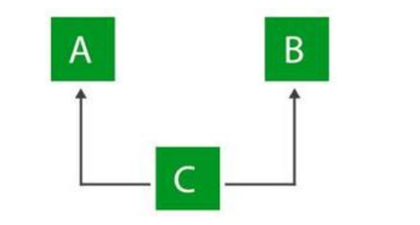
4) Multiple inheritance
In multiple inheritance there exist multiple classes and single derived class.
The concept of multiple inheritance is not supported in java through concept of classes but it can be supported through the concept of interface.
Consider a scenario where A, B, and C are three classes. The C class inherits A and B classes. If A and B classes have the same method and you call it from child class object, there will be ambiguity to call the method of A or B class.
Since compile-time errors are better than runtime errors,
Java renders compile-time error if you inherit 2 classes. So whether you have same method or different, there will be compile time error.
Why multiple inheritance is not supported in java?
To reduce the complexity and simplify the language, multiple inheritance is not supported in java.

Slide 11
class A{
void msg(){
System.out.println("Hello");}
}
class B{
void msg(){
System.out.println("Welcome");}
}
class C extends A,B{//suppose if it were
public static void main(String args[]){
C obj=new C();
obj.msg();//Now which msg() method would be invoked?
}
}

Slide 12
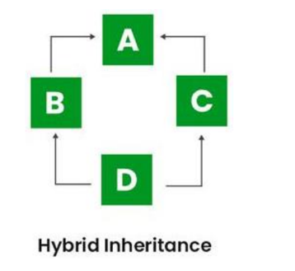
5 Hybrid inheritance
It is a mix of two or more of the above types of inheritance.
Since Java doesn’t support multiple inheritances with classes, hybrid inheritance is also not possible with classes.
In Java, we can achieve hybrid inheritance only through Interfaces.

Slide 13
SUBSTITUTABILITY
  The inheritance concept used for the number of purposes in the java programming language. One of the main purposes is substitutability.
  The substitutability means that when a child class acquires properties from its parent class, the object of the parent class may be substituted with the child class object.
  For example, if B is a child class of A, anywhere we expect an instance of A we can use an instance of B.
  The substitutability can achieve using inheritance, whether using extends or implements keywords.

Slide 14
Java Forms of Inheritance
The following are the different forms of inheritance in java.
    Specialization
    Specification
    Construction
    Extension
    Limitation
Specialization
It is the most ideal form of inheritance. The subclass is a special case of the parent class. It holds the principle of substitutability.
Specification
This is another commonly used form of inheritance. In this form of inheritance, the parent class just specifies which methods should be available to the child class but doesn't implement them. The java provides concepts like abstract and interfaces to support this form of inheritance. It holds the principle of substitutability.

Slide 15
Construction
This is another form of inheritance where the child class may change the behavior defined by the parent class (overriding). It does not hold the principle of substitutability.
Extension
This is another form of inheritance where the child class may add its new properties. It holds the principle of substitutability.
Limitation
This is another form of inheritance where the subclass restricts the inherited behavior. It does not hold the principle of substitutability.
Combination
This is another form of inheritance where the subclass inherits properties from multiple parent classes. Java does not support multiple inheritance type.

Slide 16
BENEFITS OF INHERITANCE
  Inheritance helps in code reuse. The child class may use the code defined in the parent class without re-writing it.
  Inheritance can save time and effort as the main code need not be written again.
  Inheritance provides a clear model structure which is easy to understand.
  An inheritance leads to less development and maintenance costs.
  With inheritance, we will be able to override the methods of the base class so that the meaningful implementation of the base class method can be designed in the derived class.
  In inheritance base class can decide to keep some data private so that it cannot be altered by the derived class.

Slide 17
THE COSTS OF INHERITANCE
  Inheritance decreases the execution speed due to the increased time and effort it takes, the program to jump through all the levels of overloaded classes.
  Inheritance makes the two classes (base and inherited class) get tightly coupled. This means one cannot be used independently of each other.
  The changes made in the parent class will affect the behavior of child class too.
  The overuse of inheritance makes the program more complex.

Slide 18
SUPER KEYWORD
Super keyword in java is a reference variable that is used to refer parent class features.
Usage of Java super Keyword
Super keyword At Variable Level
Super keyword At Method Level
Super keyword At Constructor Level
  Whenever the derived class is inherits the base class features, there is a possibility that base class features are similar to derived class features and JVM gets an ambiguity.
  In order to differentiate between base class features and derived class features must be preceded by super keyword.
Syntax
super.baseclass features

Slide 19
1) Super Keyword at Variable Level
  Whenever the derived class inherit base class data members there is a possibility that base class data member are similar to derived class data member and JVM gets an ambiguity.
  In order to differentiate between the data member of base class and derived class, in the context of derived class the base class data members must be preceded by super keyword.
  Syntax
super.baseclass datamember name

Slide 20
class Animal4
{
String color="white";
}
class Dog4 extends Animal4
{
String color="black";
void printColor()
{
System.out.println(color); //prints color of Dog class
System.out.println(super.color); //prints color of Animal class
}
}
class Supervariable
{
public static void main(String args[])
{
Dog4 d=new Dog4();
d.printColor();
}
}

Slide 21
2.Super Keyword at Method Level
The super keyword can also be used to invoke or call parent class method.
It should be use in case of method overriding. In other word super keyword use when base class method name and derived class method name have same name.
class Animal5
{
void eat()
{
System.out.println("eating...");
}
}
class Doggie extends Animal5
{
void eat()
{
System.out.println("eating bread...");
}
void dispay()
{
eat();
super.eat();
}
}
class Supermethod
{
public static void main(String args[])
{
Doggie d=new Doggie();
d.dispay();
}}

Slide 22
3) Super keyword At Constructor Level
The super keyword can also be used to invoke the parent class constructor.
package oppsJavaProg;
class AnimalSC {
AnimalSC() {
System.out.println("Animal class constructor"); } }
class DogSC extends AnimalSC {
DogSC() {
super(); // Calls the parent class constructor
System.out.println("Dog class constructor"); } }
public class Superconstructor {
public static void main(String[] args) {
DogSC d = new DogSC(); } }

Slide 23
Final Keyword In Java
The final keyword in java is used to restrict the user.
Final keyword is used to make a variable as a constant.
Restrict method overriding, Restrict inheritance
class In java language final keyword can be used in following ways:
  Final Keyword at Variable Level
  Final Keyword at Method Level
  Final Keyword at Class Level
The final keyword can be applied with the variables,
A final variable that have no value it is called blank final variable or uninitialized final variable.
It can be initialized in the constructor only.
The blank final variable can be static also which will be initialized in the static block only.

Slide 24
1. Final at variable level
  A variable declared with the final keyword cannot be modified by the program after initialization.
  This is useful to universal constants, such as "PI".
Example
class Bike
{
final int speedlimit=90; void run()
{
speedlimit=400;
}
public static void main(String args[])
{
Bike9 obj=new Bike9(); obj.run();
}
}
Output: Compile Time Error

Slide 25
2. Final Keyword at method level
It makes a method final, meaning that sub classes can not override this method.
The compiler checks and gives an error if you try to override the method.
When we want to restrict overriding, then make a method as a final.
class Bike
{
final void run()
{
System.out.println("running");
}
}
class Honda extends Bike
{
void run()
{
System.out.println("running safely with 100kmph");
}
public static void main(String args[])
{
Honda honda= new Honda(); honda.run();
}
}
Output: It gives an error

Slide 26
3. Final Keyword at Class Level
It makes a class final, meaning that the class cannot be inheriting by other classes. When we want to restrict inheritance then make class as a final.
Example
final class Bike
{
}
class Honda1 extends Bike
{
void run()
{
System.out.println("running safely with 100kmph");
}
public static void main(String args[])
{
Honda1 honda= new Honda1(); honda.run();
} }
Output: Compile Time Error

Slide 27
POLYMORPHISM
The polymorphism is the process of defining same method with different implementation. That means creating multiple methods with different behaviors.
Types of Java polymorphism
The Java polymorphism is mainly divided into two types:
Compile-time Polymorphism(Method Overloading)
Runtime Polymorphism(Method Overriding)
1) Ad Hoc Polymorphism(Method Overloading)
Whenever same method name is exiting multiple times in the same class with different number of parameter or different order of parameters or different types of parameters is known as method overloading.

Slide 28
package oppsJavaProg;
public class MethodOverLoading {
int add(int a, int b) {
return a + b;
}
int add(int a, int b, int c) {
return a + b + c;
}
double add(double a, double b) {
return a + b;
}
public static void main(String[] args) {
MethodOverLoading obj = new MethodOverLoading();
System.out.println(obj.add(10, 20));
System.out.println(obj.add(10, 20, 30));
System.out.println(obj.add(10.5, 20.5));
}
}

Slide 29
Pure Polymorphism(Method Overriding)
Whenever same method name is existing in both base class and derived class with same types of parameters or same order of parameters is known as method
Note: Without Inheritance method overriding is not possible.
class Walking
{ void walk()
{ System.out.println("Man walking fastly"); } }
class Man extends Walking
{ void walk() {
System.out.println("Man walking slowly");
super.walk(); } }
class PolyOverriding
{
public static void main(String args[])
{
Man m = new Man();
m.walk();
}
}

Slide 30
Overriding
In a java programming language, pure polymorphism carried out with a method overriding concept.
whenever we are calling overridden method using derived class object reference the highest priority is given to current class (derived class). We can see in the above example high priority is derived class.
super. (super dot) can be used to call base class overridden method in the derived class.

Slide 31
ABSTRACT CLASS
A class which is declared with the abstract keyword is known as an abstract class in Java. It can have abstract and non-abstract methods (method with the body).
An abstract class must be declared with an abstract keyword.
It cannot be instantiated. It can have constructors and static methods also.
It can have final methods which will force the subclass not to change the body of the method.
Abstraction is a process of hiding the implementation details and showing only functionality to the user. There are two ways to achieve abstraction in java.
  Abstract class (0 to 100%)
  Interface (100%)
Syntax
abstract class className
{
......
}

Slide 32
package oppsJavaProg;
abstract class Shape
{
// Abstract method
abstract void draw();
}
class Rectangle extends Shape
{
// Concrete method
void draw()
{
System.out.println("drawing rectangle");
}
}
class Circle1 extends Shape
{
void draw()
{
System.out.println("drawing circle");
}
}
class Abstractclass
{
public static void main(String args[])
{
Shape s = new Circle1();
s.draw();
}
}

Slide 33
ABSTRACT METHOD
An abstract method contains only declaration or prototype but it never contains body or definition.
In order to make any undefined method as abstract whose declaration is must be predefined by abstract keyword.
Syntax:-
abstract returntype methodName(List of formal parameter);

Slide 34
package oppsJavaProg;
abstract class Shape
{
abstract void draw();
}
class Rectangle extends Shape
{
void draw()
{
System.out.println("drawing rectangle");
}
}
class Circle1 extends Shape
{
void draw()
{
System.out.println("drawing circle");
}
}
class Abstractclass
{
public static void main(String args[])
{
Shape s = new Circle1();
s.draw();
}
}

Slide 35
public class AbstractMethod
{
public static void
main(String[] args)
{
Rectangle rec = new
Rectangle();
rec.printArea();
Triangle tri = new
Triangle();
tri.printArea();
Cricle cri = new Cricle();
cri.printArea();
}
}
package oppsJavaProg;
import java.util.*;
abstract class AreaFormula
{ int length, breadth, radius;
Scanner input = new Scanner(System.in);
abstract void printArea();
}
class Rectangle extends AreaFormula
{ void printArea()
{
System.out.println("*** Finding the Area of Rectangle ***");
System.out.print("Enter length and breadth: ");
length = input.nextInt();
breadth = input.nextInt();
System.out.println("The area of Rectangle is: " + length * breadth);
}
}
class Triangle extends AreaFormula
{
void printArea()
{
System.out.println("\n*** Finding the Area of Triangle ***");
System.out.print("Enter Base And Height: ");
length = input.nextInt();
breadth = input.nextInt();
System.out.println("The area of Triangle is: " + (length * breadth) / 2);
}
}
class Cricle extends AreaFormula
{
void printArea()
{
System.out.println("\n*** Finding the Area of Circle ***");
System.out.print("Enter Radius: ");
radius = input.nextInt();
System.out.println("The area of Circle is: " + 3.14f * radius * radius);
}
}

Slide 36
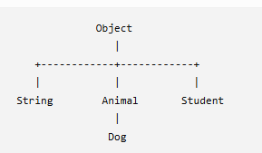
OBJECT CLASS
In java, the Object class is the super most class of any class hierarchy. The Object class in the java programming language is present inside the java.lang package.
Every Java class directly or indirectly inherits from java.lang.Object.
Every class in the java programming language is a subclass of Object class by default.
The Object class is useful when you want to refer to any object whose type you don't know. Because it is the superclass of all other classes in java, it can refer to any type of object.

Slide 37
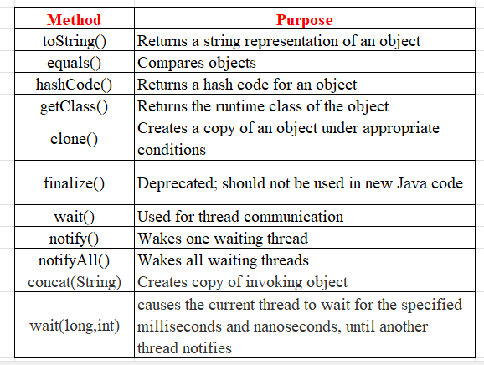

Slide 38
class Blockchain
{
String Blocknode = "CHS281098";
}
class Miner
{
int minerid = 101;
}
public class HashCodeExample
{
public static void main(String args[])
{
Blockchain s = new Blockchain();
Miner m = new Miner();a
System.out.println("Hash Code: " + s.hashCode());
System.out.println("Hash Code: " + m.hashCode());
}
}

Slide 39
PACKAGES IN JAVA
A package is a collection of similar types of classes, interfaces and sub-packages.
Types of packages
Package are classified into two type which are given below.
Predefined or built-in package
User defined package
Predefined or built-in package
These are the packages which are already designed by the Sun Microsystem and supply as a part of java API, every predefined package is collection of predefined classes, interfaces and sub-package.
User defined package
  If any package is design by the user is known as user defined package.
  User defined package are those which are developed by java programmer and supply as a part of their project to deal with common requirement.

Slide 40
Following are the list of predefined packages in java
  java.lang − This package provides the language basics.
  java.util − This packages provides classes and interfaces (API’s) related to collection frame work, events, data structure and other utility classes such as date.
  java.io − This packages provides classes and interfaces for file operations, and other input and output operations.
  java.awt − This packages provides classes and interfaces to create GUI components in Java.
  java.time − The main API for dates, times, instants, and durations.
  We use package for the following reasons:
  The package makes the search easier for the classes and interfaces.
  It provides a fully qualified name that avoids naming conflicts.
  It also controls access.
  It organizes classes in a folder structure.
  It improves code reusability.
  Programmer can group classes and interfaces into a related package.

Slide 41
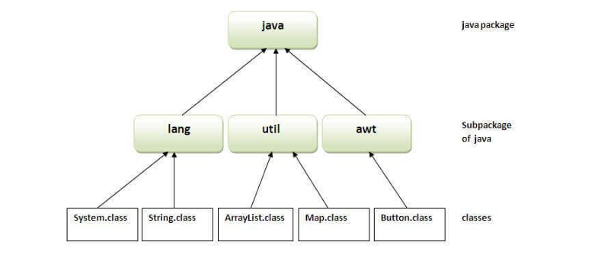

Slide 42
DEFINING A PACKAGE
Rules to create user defined package
  Package statement should be the first statement of any package program.
  Syntax:- package packageName;
  Choose an appropriate class name or interface name and whose modifier must be public.
  package college;
  public class Student{ }
  Any package program can contain only one public class or only one public interface but it can contain any number of normal classes.
  college
  |
  +--- Student.java
  |
  +--- Teacher.java
  Package program should not contain any main() method.
  A class inside a package can contain main().

Slide 43
DEFINING A PACKAGE
Rules to create user defined package
5. Modifier of constructor of the class which is present in the package must be public. (This is not applicable in case of interface because interface have no constructor.)
package college;
public class Student
{
public Student()
{
System.out.println("Student constructor");
}
public void display()
{
System.out.println("Student details");
}
}
package test;
import college.Student;
public class TestStudent
{
public static void main(String args[])
{
Student s = new Student();
s.display();
}
}

Slide 44
DEFINING A PACKAGE
Rules to create user defined package
  The modifier of method of class or interface which is present in the package must be public (This rule is optional in case of interface because interface methods by default public)
  package college;
  public class Student
  {
  public void display()
  {
  System.out.println("Student details");
  }
  }
  Every package program should be save either with public class name or public Interface name
  If you omit the package statement, the class names are put into the default package, which has no name.

Slide 45
DEFINING A PACKAGE
Rules to create user defined package
  Every package program should be save either with public class name or public Interface name.
  package college; public class Student
  public class Student { } ↓
  Student.java
  If you omit the package statement, the class names are put into the default package, which has no name.

Slide 46
IMPORTING PACKAGES
  To import the java package into a class, we need to use the java import keyword which is used to access the package and its classes into the java program.
  Use import to access built-in and user-defined packages into your java source file to refer to a class in another package by directly using its name.
Using packagename.*
If you use package.* then all the classes and interfaces of this package will be accessible but not subpackages. The import keyword is used to make the classes and interface of another package accessible to the current package.
2) Using packagename.classname
If you import package.classname then only declared class of this package will be accessible.
syntax:
import package.name.ClassName; // To import a certain class only
import package.name.* // To import the whole package
Example:
import java.util.Date; // imports only Date class
import java.io.*; // imports everything inside java.io package

Slide 47
CLASSPATH
CLASSPATH can be set by any of the following ways:
CLASSPATH can be set permanently in the environment:
In Windows, choose control panel
System
Advanced
Environment Variables
choose “System Variables” (for all the users) or “User Variables” (only the currently login user)
choose “Edit” (if CLASSPATH already exists) or “New”
Enter “CLASSPATH” as the variable name
Enter the required directories and JAR files (separated by semicolons) as the value (e.g., “.;c:\javaproject\classes;d:\tomcat\lib\servlet-api.jar”).
Take note that you need to include the current working directory (denoted by ‘.’) in the CLASSPATH.

Slide 48
INTERFACES
  An interface in Java is a blueprint of a class. which is collection of public static final variables (constants) and abstract methods.
  The interface is a mechanism to achieve fully abstraction in java. There can be only abstract methods in the interface. It is used to achieve fully abstraction and multiple inheritance in Java.
  In other words, you can say that interfaces can have abstract methods and variables. It cannot have a method body.
  Java Interface also represents the IS-A relationship.
  It cannot be instantiated just like the abstract class.
  Since Java 8, we can have default and static methods in an interface.
  Since Java 9, we can have private methods in an interface.
Why use Java interface?
There are mainly three reasons to use interface. They are given below.
It is used to achieve abstraction.
By interface, we can support the functionality of multiple inheritance.
It can be used to achieve loose coupling.

Slide 49
Defining Interfaces
An interface is declared by using the interface keyword.
It provides total abstraction; means all the methods in an interface are declared with the empty body, and all the fields are public, static and final by default.
A class that implements an interface must implement all the methods declared in the interface.
Syntax:-
interface <interface_name>{
// declare constant fields
// declare methods that abstract
// by default.
}

Slide 50
IMPLEMENTING INTERFACES
A class uses the implements keyword to implement an interface.
interface A
{
public static final int a = 10; void display();
}
class B implements A
{
public void display()
{
System.out.println("Hello");
}
}
class InterfaceDemo
{
public static void main (String[] args)
{
B obj= new B(); obj.display(); System.out.println(A.a);
}
}

Slide 51
IMPLEMENTING INTERFACES
A class uses the implements keyword to implement an interface.
interface A
{
public static final int a = 10; void display();
}
class B implements A
{
public void display()
{
System.out.println("Hello");
}
}
class InterfaceDemo
{
public static void main (String[] args)
{
B obj= new B(); obj.display(); System.out.println(A.a);
}
}

Slide 52
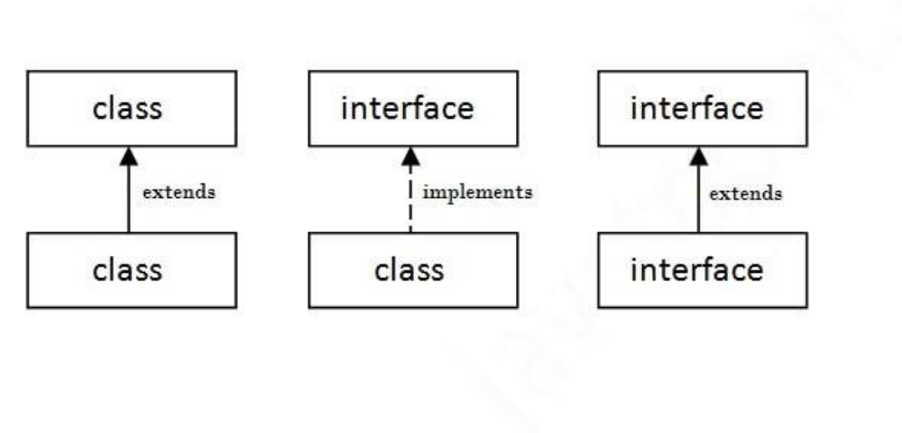
The relationship between classes and interfaces
As shown in the figure given below, a class extends another class, an interface extends another interface, but a class implements an interface.

Slide 53
package interfaces;
interface printable{
void print();
}
class InterfaceImplements implements printable{
public void print()
{
System.out.println("InterfaceImplements");
}
public static void main(String args[]){
InterfaceImplements obj = new InterfaceImplements();
obj.print();
}
}

Slide 54
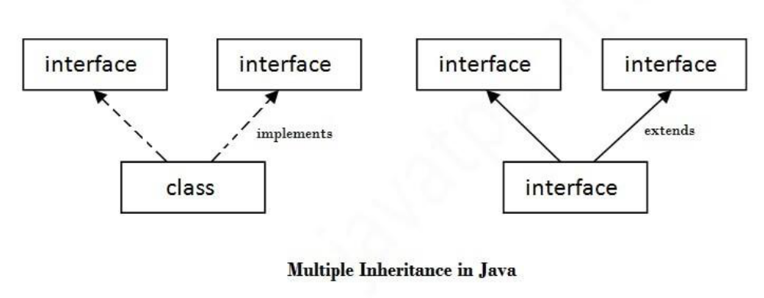
Multiple inheritance in Java by interface
If a class implements multiple interfaces, or an interface extends multiple interfaces, it is known as multiple inheritance.

Slide 55
package interfaces;
interface Printable {
void print();
}
interface Showable {
void show();
}
class MultipleInheritance implements Printable,Showable {
public void print() {
System.out.println("Hello");
}
public void show() {
System.out.println("Welcome");
}
public static void main(String args[]) {
MultipleInheritance obj = new MultipleInheritance();
obj.print();
obj.show();
}
}

Slide 56
Interface inheritance
A class implements an interface, but one interface extends another interface.
interface Printable {
void print();
}
interface Showable extends Printable {
void show();
}
class TestInterface4 implements Showable {
public void print() {
System.out.println("Hello");
}
public void show() {
System.out.println("Welcome");
}
public static void main(String args[]) {
TestInterface4 obj = new TestInterface4();
obj.print();
obj.show();
}
}

